Slide 1
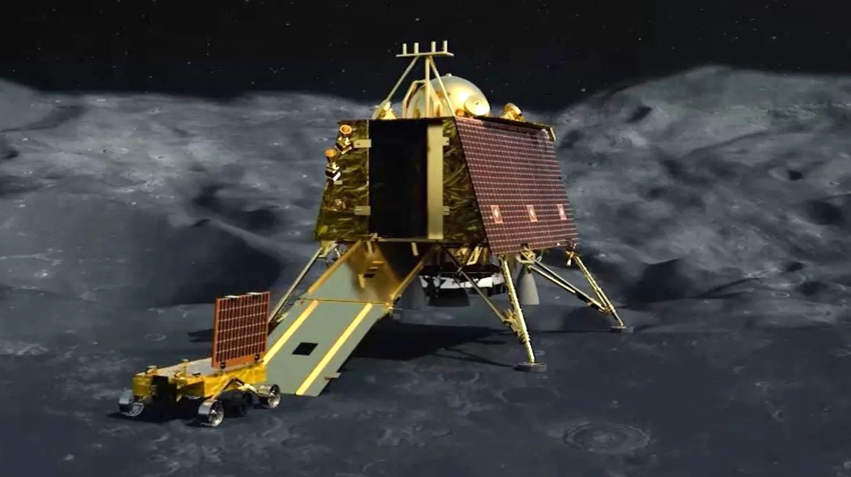

MANAGERIAL ECONOMICS
NEWS ANALYSIS
Presented by: Deepti Meher
(Bill Gates Batch)

Slide 2
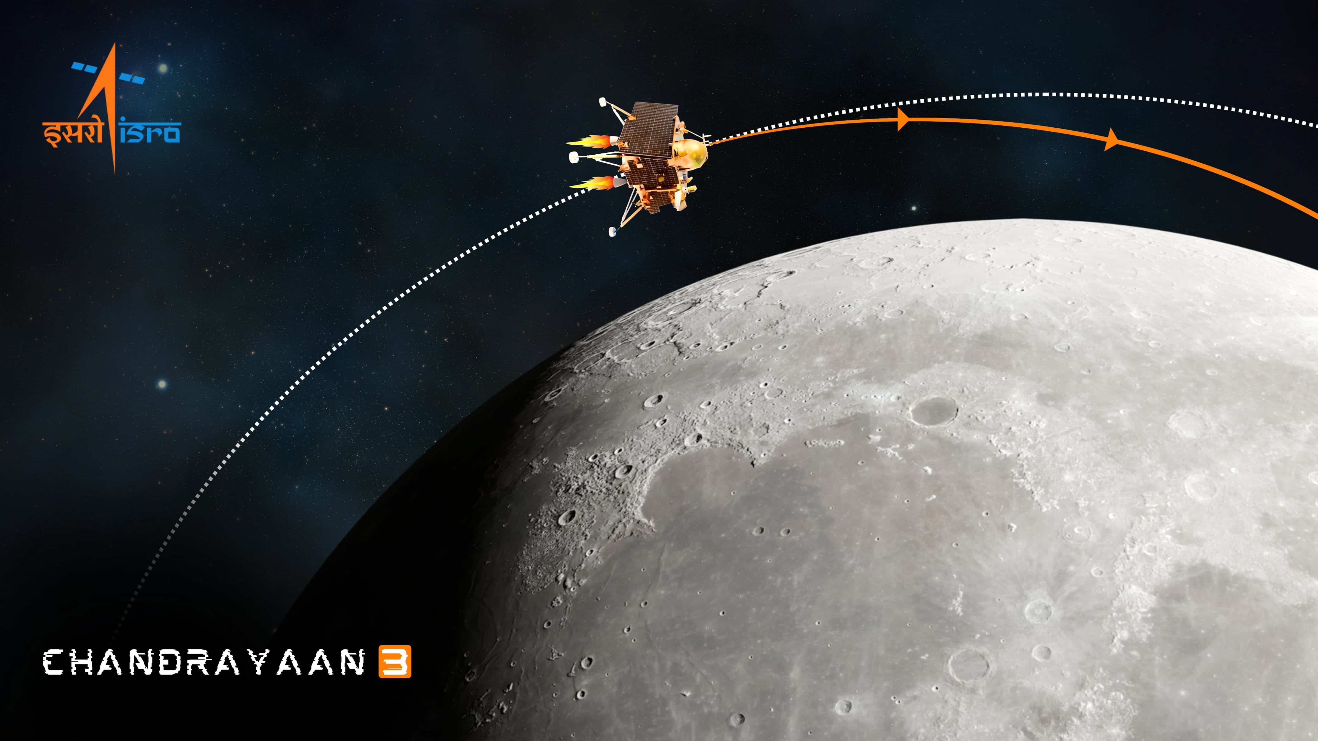
CHANDRAYAAN 3

Slide 3
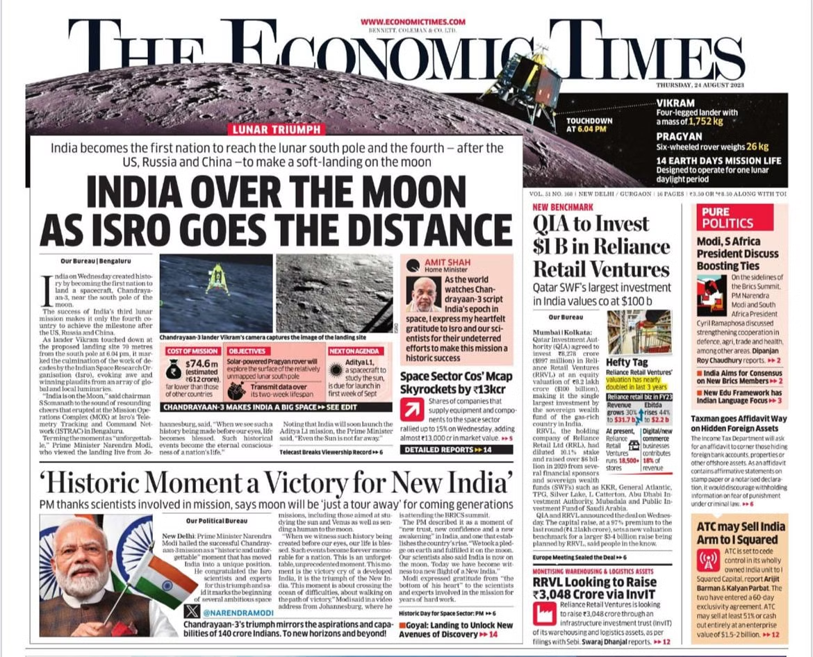
KEY POINTS:
According to the former Chairman of ISRO, K Sivan, the total cost of Chandrayaan-3 is Rs. 615 crore.
The lander, rover, and propulsion cost around Rs. 215 crore and the launch costs around Rs. 365 crore.
Chandrayaan-3 costs less than many blockbuster films, according to Forbes, such as “The Martian” ($108 million) and “The Interstellar” ($145 million).
However, this time ISRO had opted for a failure-proof model instead of a success-based model to ensure that India writes its name on history book pages by becoming the first nation to land on the South pole of the Moon

Slide 4
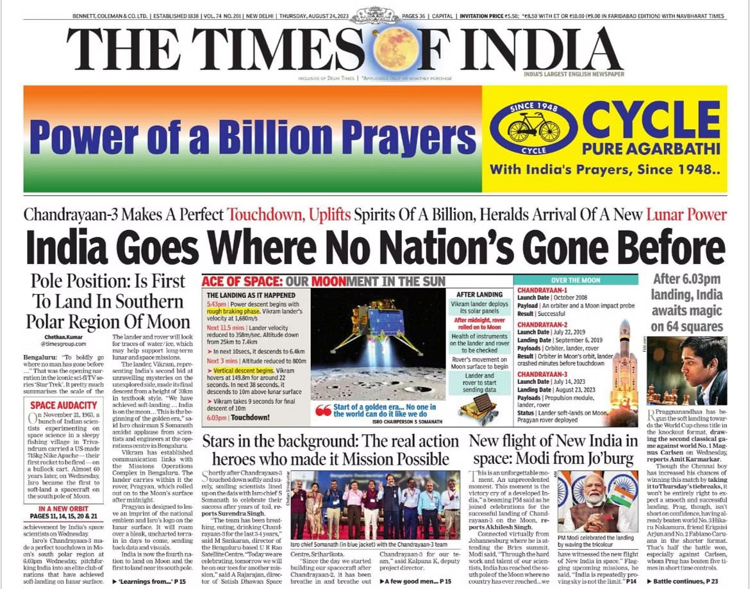
1. Chandrayaan-3 Lands on Moon: Successful touchdown in the Moon's southern polar region. 2. National Pride: Uplifts the spirits of a billion Indians; marks India as a new lunar power. 3. Historical Achievement: First nation to land in the southern polar region; landing occurred after 6:03 PM. 4. Contributions and Celebrations: Acknowledgment of mission heroes; new aspirations for India's space program.
KEY POINTS :

Slide 5
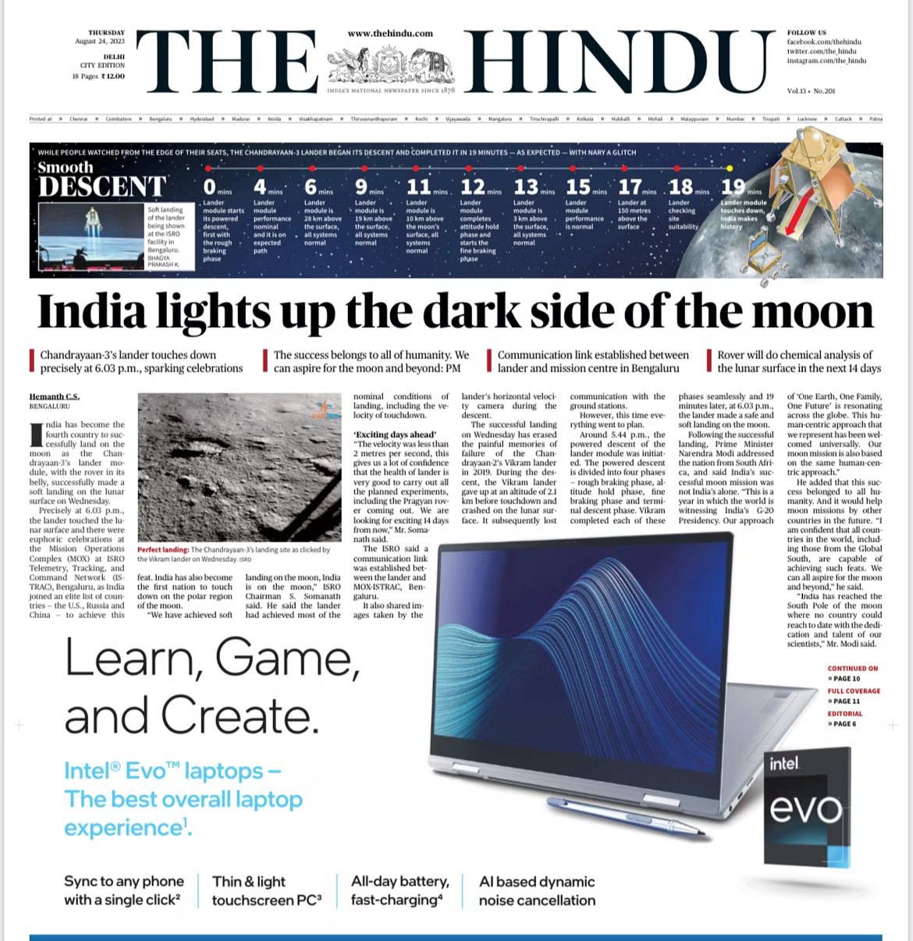
KEY POINTS:
Chandrayaan-3's lander touches down precisely at 6.03 p.m., sparking celebrations
The success belongs to all I of humanity, We can aspire for the moon and beyond
Communication link established between lander and mission center in Bengaluru
Rover will do chemical analysis of the lunar surface in the next 14 days

Slide 6
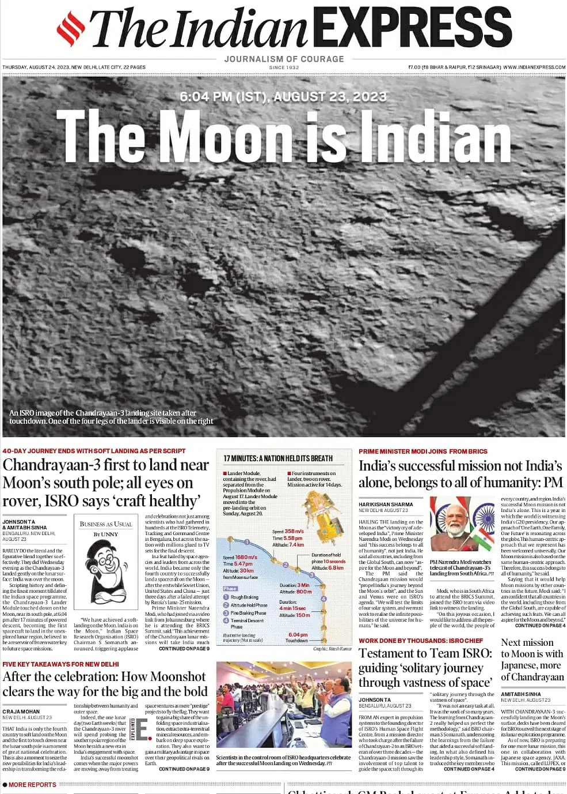
KEY POINTS:
India become only the fourth country to successfully land on spacecraft on the moon
India’s successful mission not India’s alone belong to all of humanity.
Next mission to moon is with Japanese more of Chandrayaan.

Slide 7
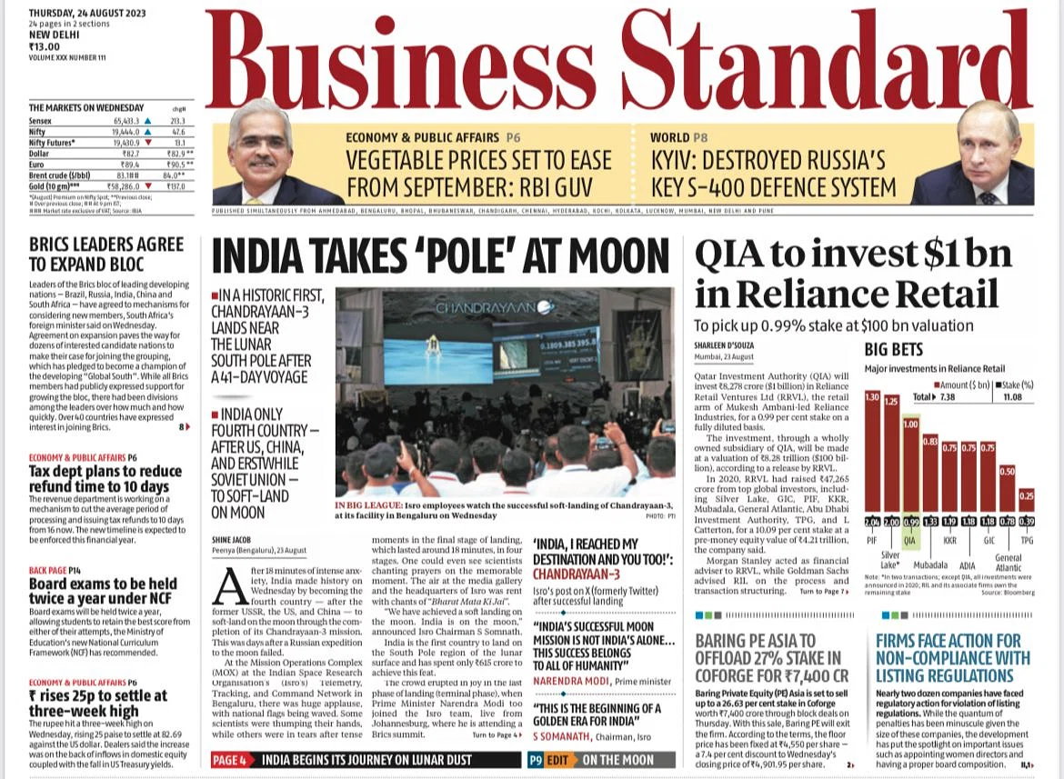
KEY POINTS:
In a historic first, chandrayaan-3 lands near the lunar south pole after a41-day voyage
India only fourth country- after us, China, and erstwhile soviet union - to soft-land on moon
"This is the beginning of a golden era for India by “S Somanath, chairman, ISRO

Slide 8
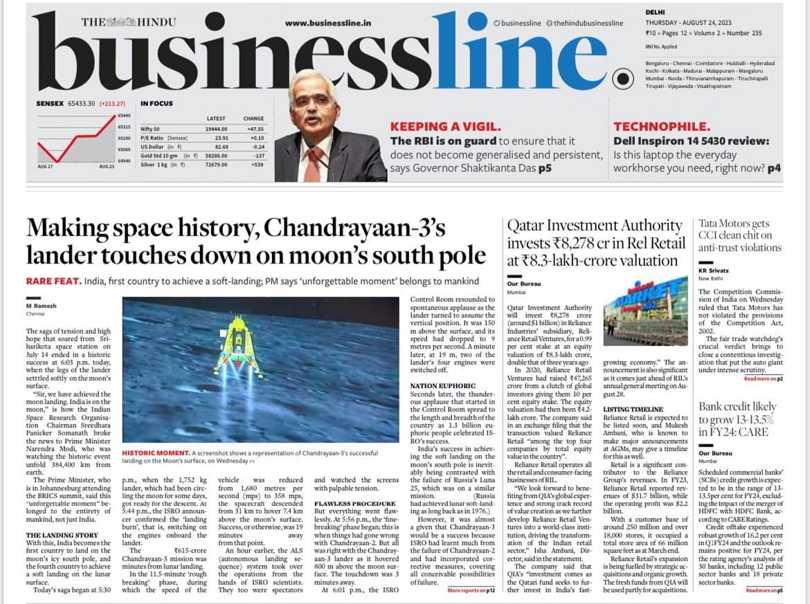
KEY POINTS:
Chandrayaan-3 consists of an indigenous Lander module (LM), Propulsion module (PM) and a Rover with an objective of developing and demonstrating new technologies required for Inter planetary missions.
The launcher identified for Chandrayaan-3 is LVM3 M4 which will place the integrated module in an Elliptic Parking Orbit (EPO) of size ~170 x 36500 km.
Mission Life (Lander & Rover) One lunar day (~14 Earth days)

Slide 9
SUMMARY
The Lander is designed to softly land at a specified lunar site and deploy the Rover, which will conduct in-situ chemical analysis of the lunar surface during its mobility.
Both the Lander and the Rover carry scientific payloads to perform experiments on the lunar surface.
The primary function of the Propulsion module is to transport the LM from launch vehicle injection to the final lunar orbit of 100 km and then separate from the LM.
Additionally, the Propulsion module houses a scientific payload for post-separation operation.
The GSLV-Mk3 launcher has been selected for Chandrayaan-3, which will place the integrated module in an elliptic parking orbit of approximately 170 x 36,500 km.
The Propulsion module will transport the Lander and Rover to a lunar orbit of 100 km.

Slide 10
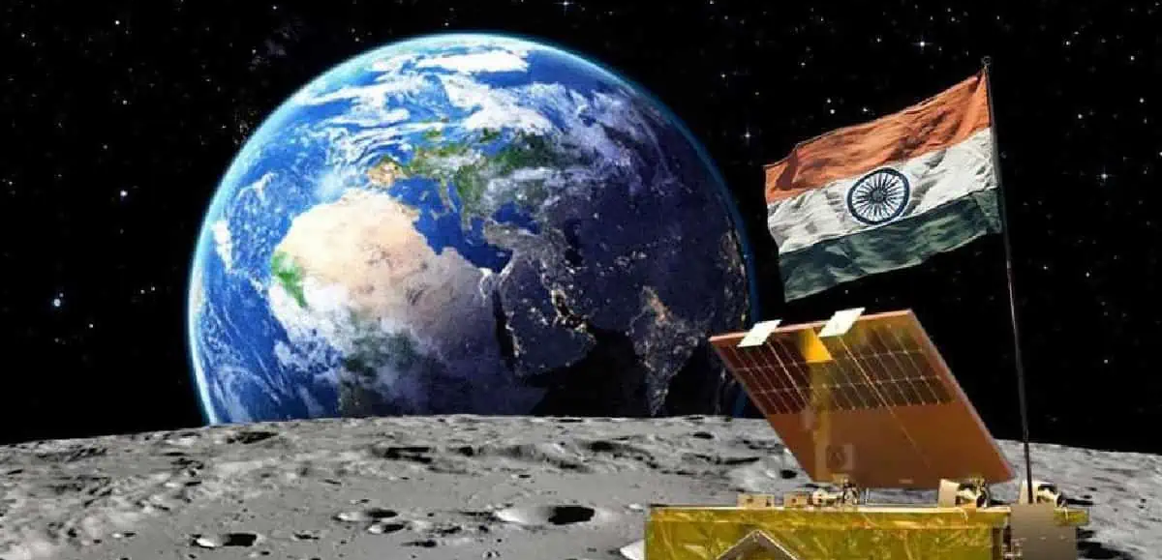
THANK YOU

